Slide 1
Many-light methods – Clamping & compensation
Jaroslav Křivánek
Charles University, Prague

Slide 2
Instant radiosity
Approximate indirect illumination by
Virtual Point Lights (VPLs)
Generate VPLs
Render with VPLs

Slide 3
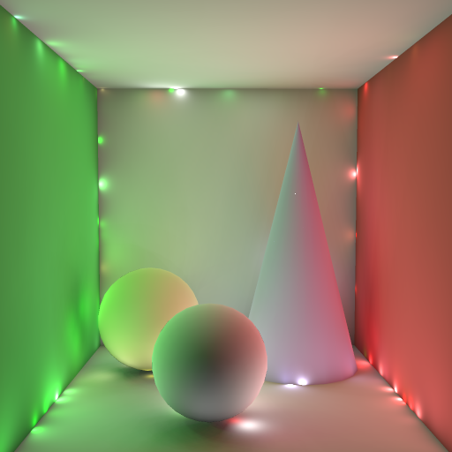
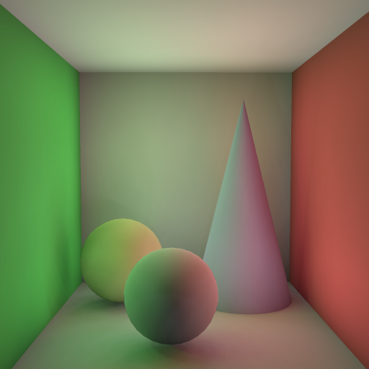
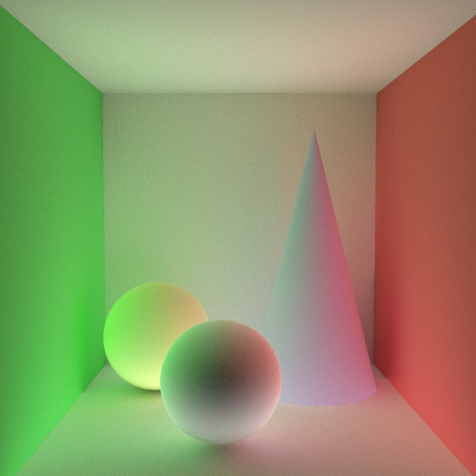
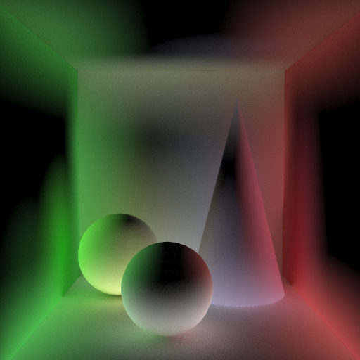
Clamping
1000 VPLs - no clamping
1000 VPLs - clamping
reference (path tracing)
missing energy

Slide 4
Clamping Compensation
Kollig & Keller, MCQMC 2004

Slide 5
Idea
Clamping reduces variance but some energy is lost
Find formula for the lost energy
Compute the lost energy by selective path tracing
full solution
clamping
path tracing compensation

Slide 6
Clamping
VPL power
VPL emission distribution
(BRDF lobe at p – for a diffuse VPL can be folded into Φ)
min{ c,
}
Geometry term
p
Visibility
ω_{o}
x

Slide 7
Formal derivation
Clamping evaluates this equation
Can be written as

Slide 8
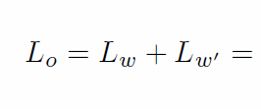
What’s missing?
Unbiased solution
VPLs w/ clamping
Path tracing compensation of the clamped energy

Slide 9
Result
Compensation faster than path tracing everything (many path terminated early)
full solution
clamping
path tracing compensation

Slide 10
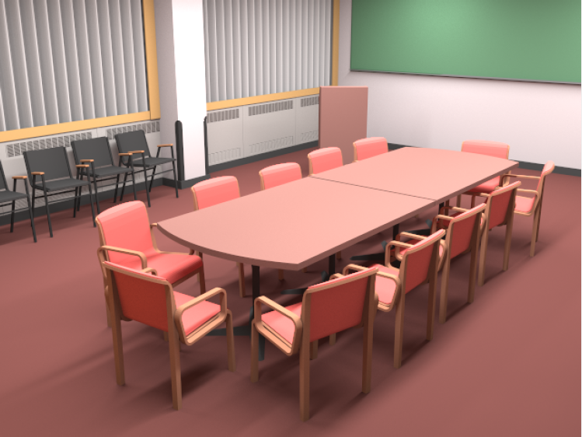
Biased result with clamping

Slide 11
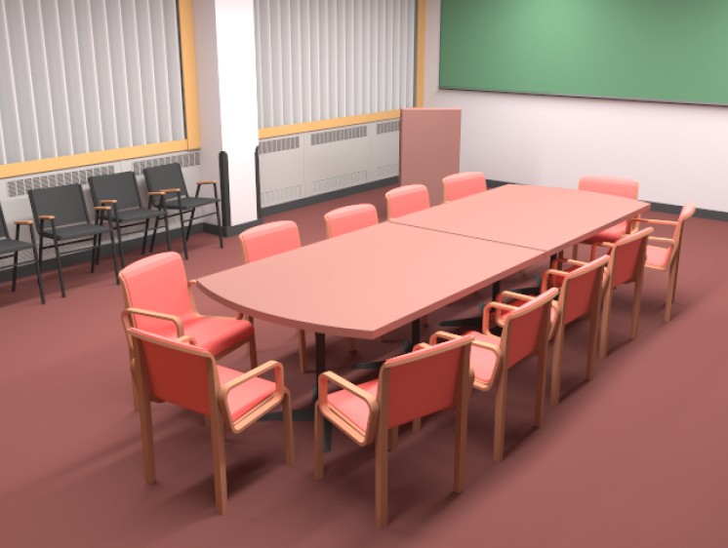
Unbiased result with compensation

Slide 12
Dealing with Glossy Transport

Slide 13
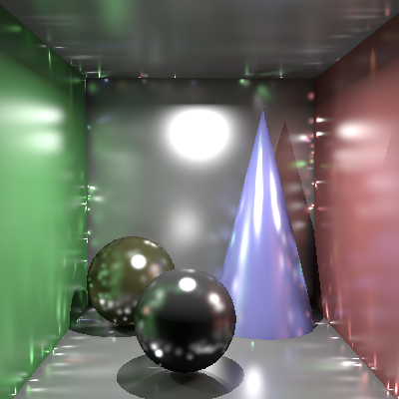
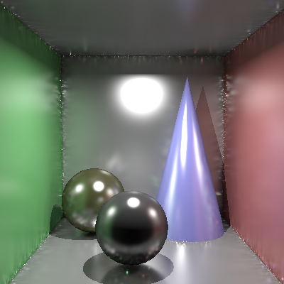
Instant radiosity with glossy surfaces
Ground truth
1,000 VPLs
100,000 VPLs

Slide 14
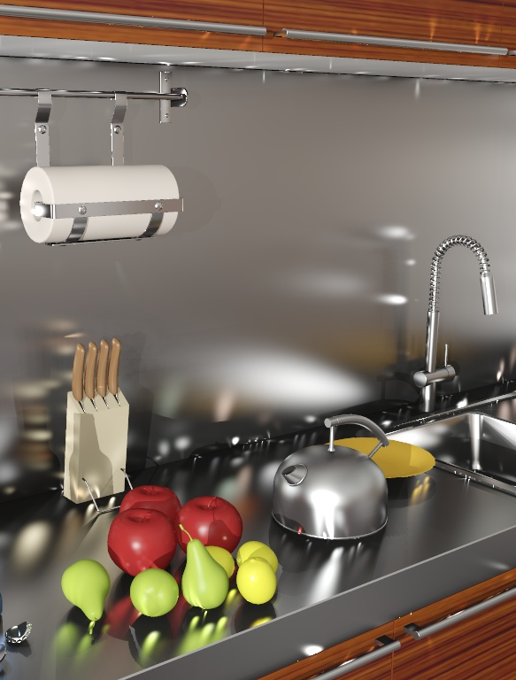
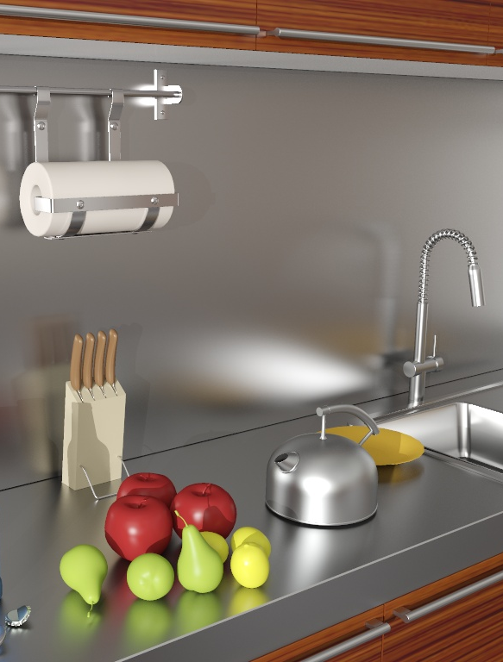
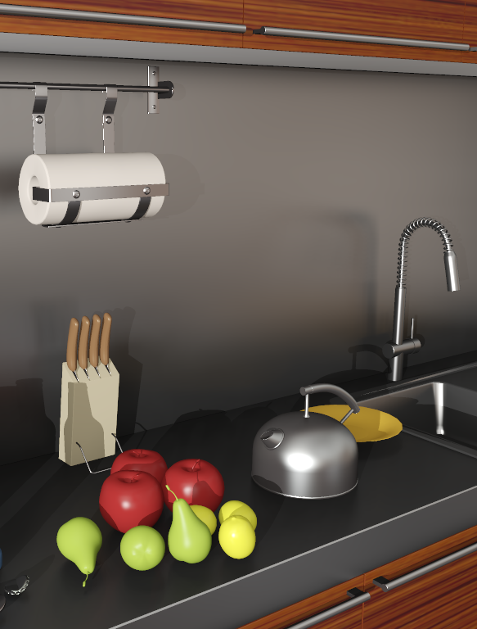
Effect of clamping
VPL
GI reference
VPLs w/ clamping
artifacts
material change

Slide 15
Virtual Spherical Lights
Hašan, Křivánek & Bala, SIGGRAPH Asia 2009

Slide 16
Emission distribution of a VPL
Cosine-weighted BRDF lobe at the VPL location
Glossy
Diffuse

Slide 17
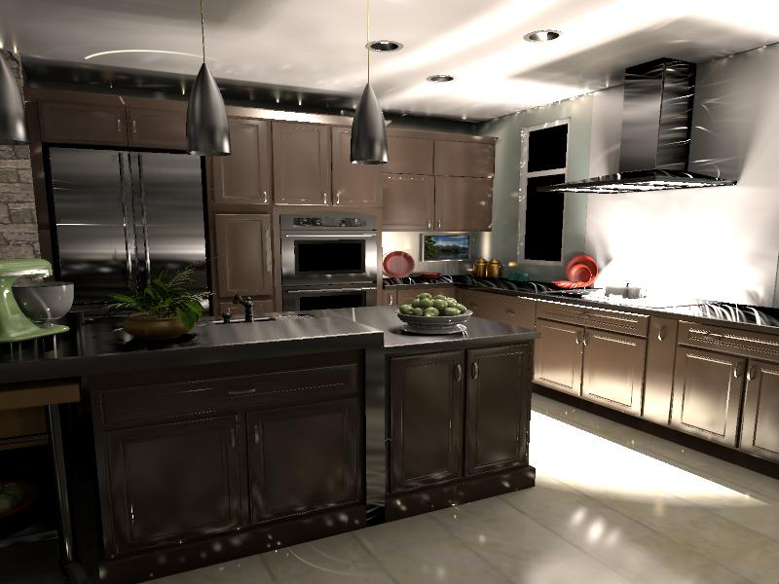
Glossy VPL emission: illumination spikes
Common solution: Only diffuse BRDF at light location
Notes:
If you render the scene with VPLs defined this way your will get an image with a lot of splotches. Each splotch corresponds to the spike in the emission distribution of a single VPL. For example, the streak on the ceiling is caused by a VPL located on a highly anisotropic glossy surface.
The common solution in instant radiosity is to ignore the glossy component of the BRDF at the light location which produces VPLs with very uniform emission distribution.

Slide 18
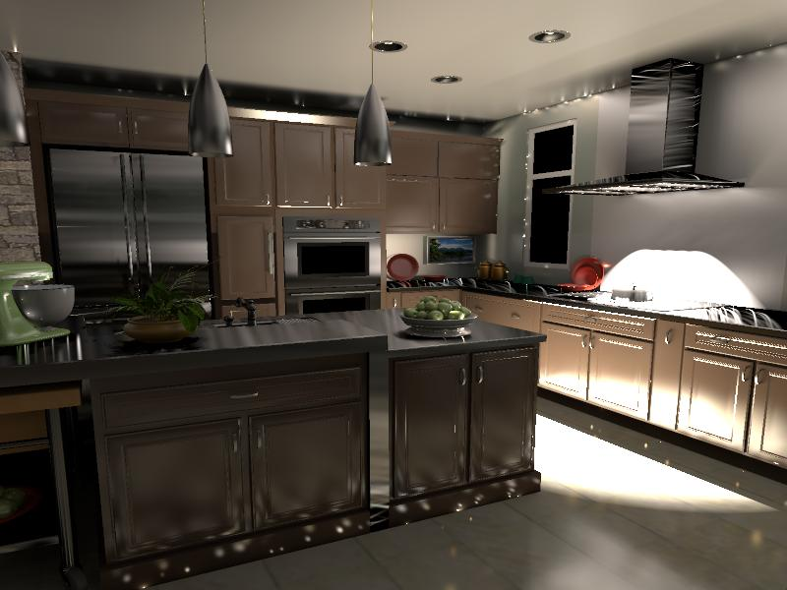
Remaining spikes

Slide 19
Remaining spikes
VPL contribution = VPL power . BRDF(x) . cos(x) . 1 / || p – x ||²
As || p – x || → 0, VSL contribution → ∞
p
spike!
x
x
Common solution: Clamp VPL contributions

Slide 20
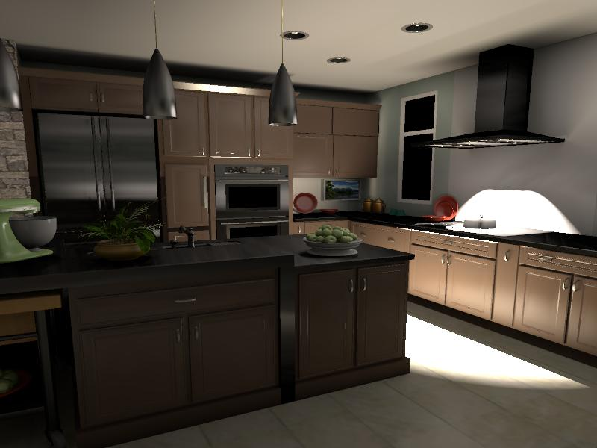
Instant radiosity: The practical version
Clamping and diffuse-only VPLs:
Illumination is lost!

Slide 21
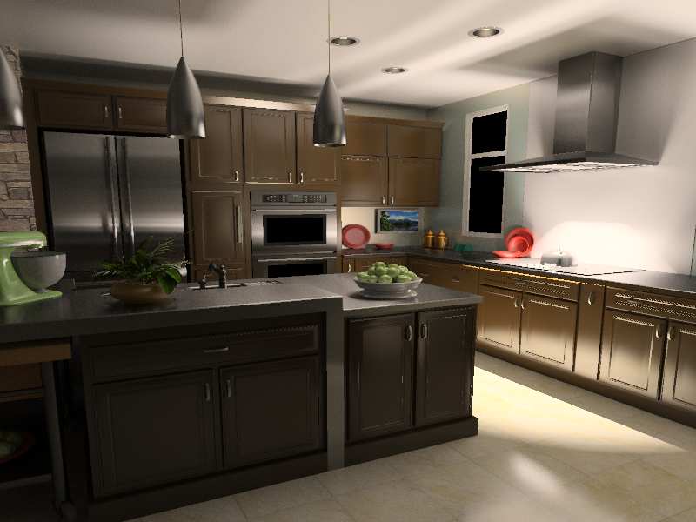
Comparison
Clamped VPLs: Illumination loss
Path tracing: Slow

Slide 22
Recall: Emission Distribution of a VPL
Spike!

Slide 23
What happens as #lights → ∞ ?
Spiky lights converge to a continuous function!

Slide 24
Idea: We want a “virtual area light”
Aggregate incoming illumination
Aggregate outgoing illumination
“Virtual area light”
Problem: What if surface is not flat?

Slide 25
VPL to VSL
Non-zero radius (r)
Integration over
non-zero solid angle
p
l
Ω
x
Notes:
More specifically, we well spread the light energy over the surfaces inside the sphere of radius r centered at the light position p. And the contribution of the light will be computed as an integral over the solid angle subtended by the sphere.

Slide 26
Light Contribution
Non-zero radius (r)
Integration over
non-zero solid angle
p
y
l
Ω
x
Notes:
Let’s write down the formula for the contribution of such a light to the surface point x. We have the integration over the solid angle. The integrand is a product of the following terms: the cosine weighted BRDF at the surface, next, the BRDF at the point y n the vicinity of the light location. Finally, we have an indicator term that is zero for all the directions that correspond to surface point y outside the sphere. We normalize the integration by the expected surface area inside the sphere, pi*r^2, and multiply by the light flux.
To avoid this indicator term, we could define the light contribution as an integral over a disk area. Unfortunately, doing that re-introduces the infamous 1/dist^2 term and produces bad results (we tried it).

Slide 27
Light Contribution
Non-zero radius (r)
Integration over
non-zero solid angle
p
y
l
Ω
Problem: Finding y requires ray-tracing
x
Notes:
Unfortunately, this formulation requires finding the point y for all directions l inside the cone, which required ray tracing. This is clearly not feasible.

Slide 28
Simplifying Assumptions
Non-zero radius (r)
Integration over
non-zero solid angle
p
y
Constant in Ω:
Visibility
Surface normal
Light BRDF
l
Ω
x
Taken from p, the light location
Notes:
To produce a computationally convenient approximation to the previous formula, we make the following simplifying assumptions. We assume that the visibility, the surface normal and the BRDF are constant inside the sphere. And we take them from the light location p.

Slide 29
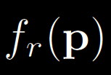
Light Contribution Updated
Non-zero radius (r)
Integration over
non-zero solid angle
p
l
Ω
x
Notes:
With these assumptions, we can write a formula for the contribution of a VSL:

Slide 30
Virtual Spherical Light
All inputs taken from x and p
Local computation
Same interface as any other light
Can be implemented in a GPU shader
Visibility factored from the integration
Can use shadow maps

Slide 31
Implementation
Matrix row-column sampling
Shadow mapping for visibility
VSL integral evaluated in a GPU shader
Need more lights than in diffuse scenes

Slide 32
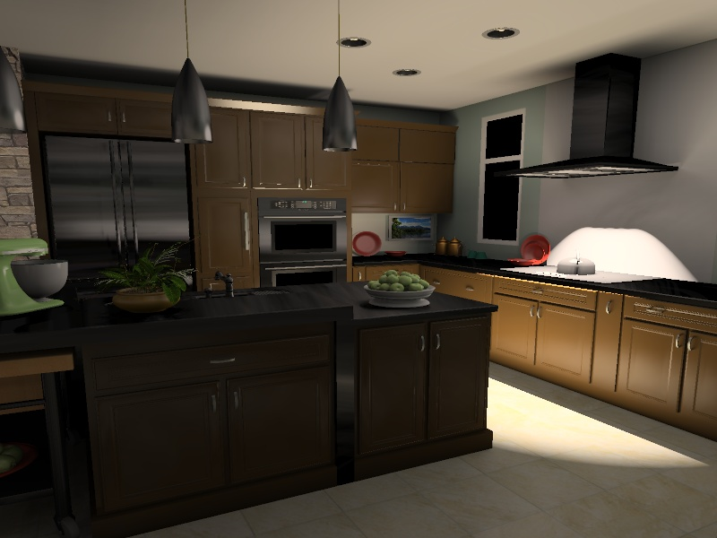
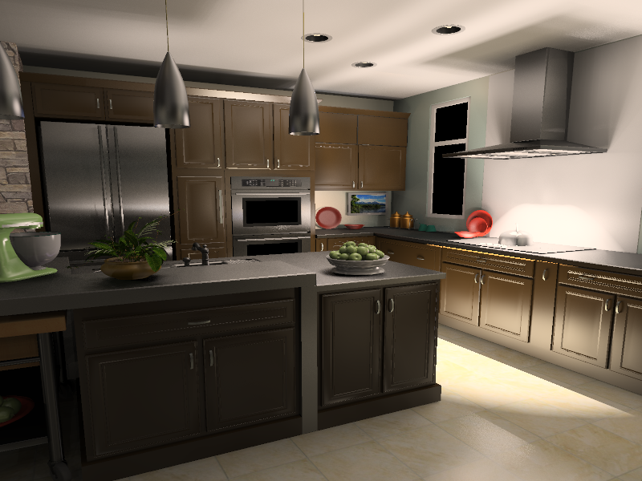
Results: Kitchen
Most of the scene lit indirectly
Many materials glossy and anisotropic
Path tracing:
316 hours (8 cores)
Clamped VPLs
34 sec (GPU) – 2000 lights
New VSLs:
4 min 4 sec (GPU) – 10000 lights

Slide 33
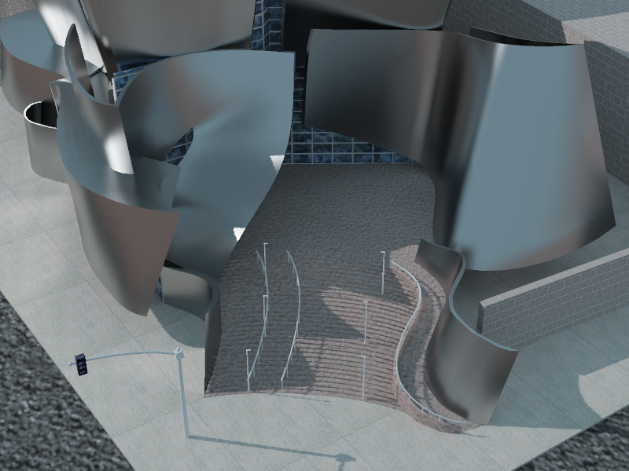
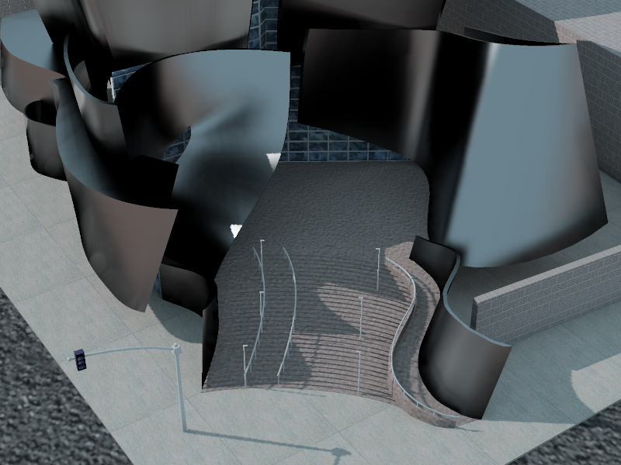
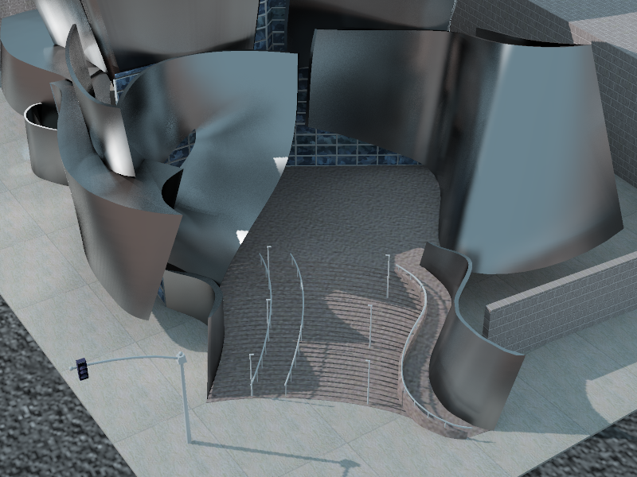
Results: Disney concert hall
Curved walls with no diffuse component
Standard VPLs cannot capture any reflection from walls
Path tracing:
30 hours (8 cores)
Clamped VPLs:
22 sec (GPU) – 4000 lights
New VSLs:
1 min 26 sec (GPU) – 15000 lights

Slide 34
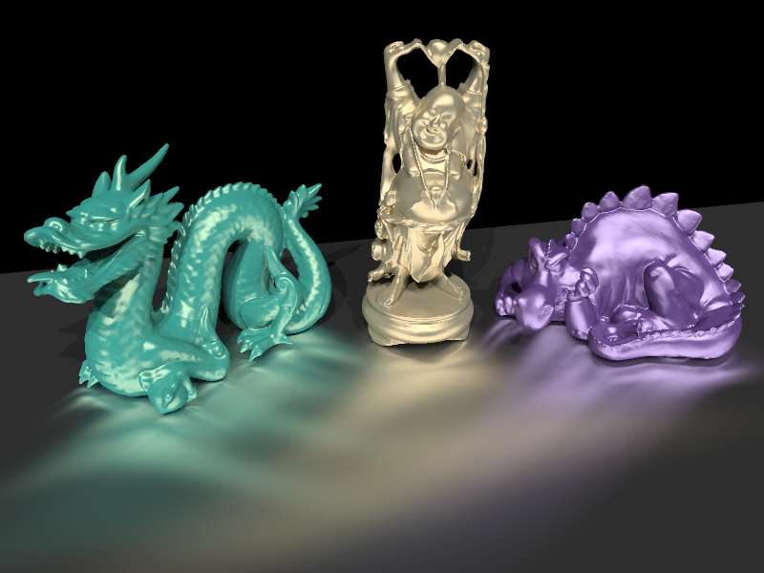
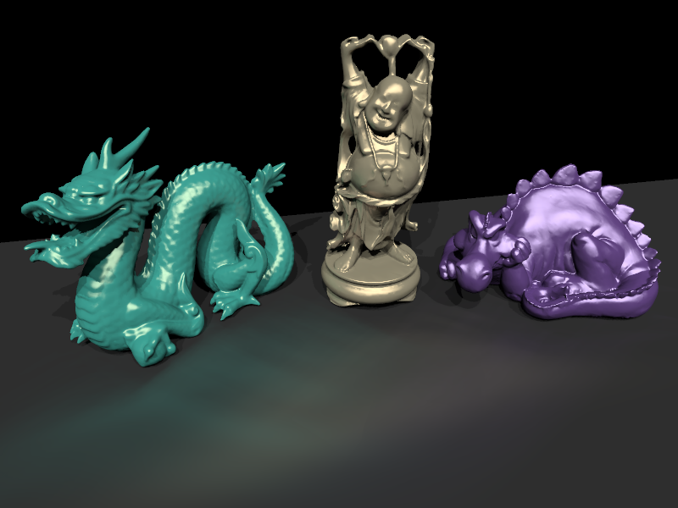
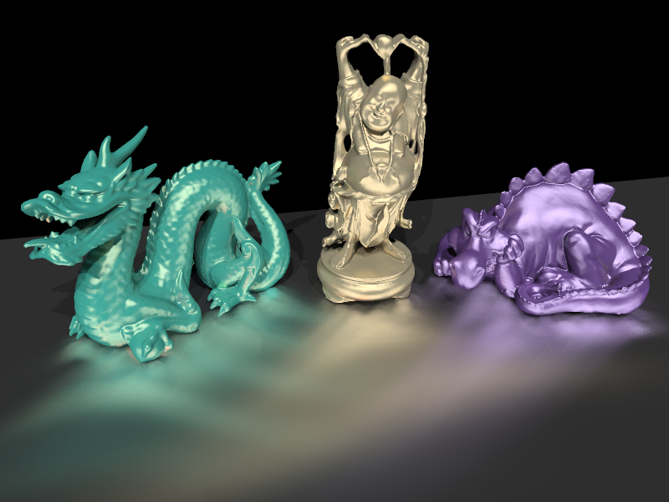
Results: Anisotropic tableau
Difficult case
Standard VPLs capture almost no indirect illumination
Path tracing:
2.2 hours (8 cores)
Clamped VPLs:
32 sec (GPU) – 1000 lights
New VSLs:
1 min 44 sec (GPU) – 5000 lights

Slide 35
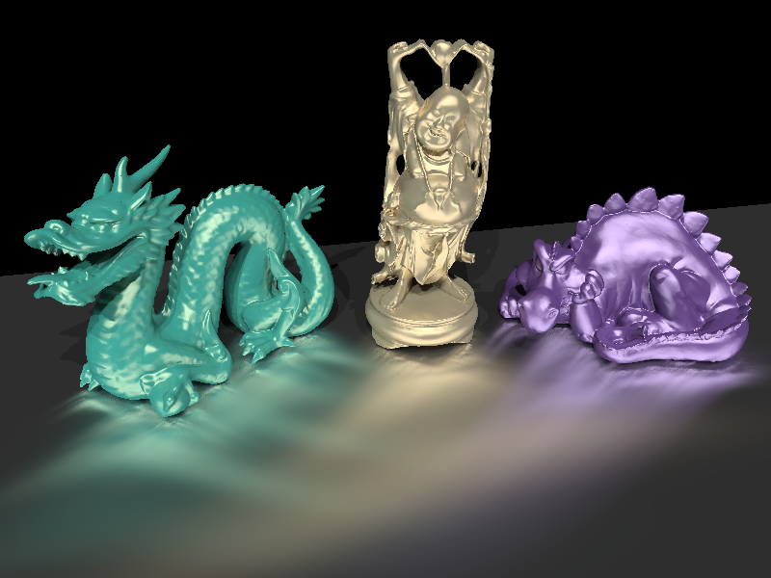
Limitations: Blurring
VSLs can blur illumination
Converges as number of lights increases
5,000 lights - blurred
1,000,000 lights - converged

Slide 36
Conclusions
Many-light methods do not deal well with glossy scenes
Artifacts or energy loss
Energy loss -> change of material perception
Handling glossy effects with many-lights
Virtual Spherical Lights
[Davidovič et al. 2010]

